Slide 1
Project on the ecological sustainability
of Flanders’ film production industry
by Kim Van den Heuvel

Slide 2
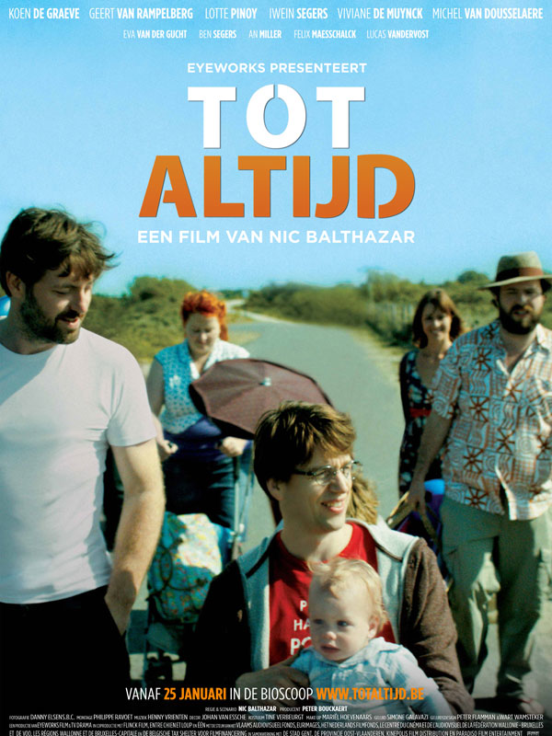
Initiatives
While temperature was rising and ice was melting, things started to move in Flanders’ film industry too:
2011-2012
Eco-Summit oktober 2011: Eco-summit @ Filmfestival Ghent
E-mission handbook: VAF and Location Flanders.
carbon neutral Flemish Film: Tot Altijd / Time of my Life
Flemish director Nic Balthazar & his producer Peter Bouckaert (Eyeworks) http://www.youtube.com/watch?v=TTOAzf-DaGM
Naar een CO2 neutrale Vlaamse Filmindustrie
Notes:
During production: trying to reduce the footprint (e-Mission handbook + using common sense):
Locations close to where most of the crew lived, instead of far away locations (= reduction of transport) + carpooling + hotel instead of driving + bikes instead of cars
During shooting: stone cups for everyone instead of plastic / cardboard ones
…
After production:
Calculation of the carbon footprint by Serge De Gheldere (Futureproofed)
To compensate the emission, solar panels were installed on the roof of the Eyeworks offices
VAF & Futureproofed organised a case study

Slide 3
Project
2013-2014
Project on the ecological sustainability of Flanders’ film production industry
Financed by Flemish Film Fund (VAF - Vlaams Audiovisueel Fonds)
March 2013 – now
External partner that is specialised in eco consultancy: Zero Emission Solutions
Research and training
Collect data on a structural basis: CARBON CALCULATOR
What actions are most polluting?
Where lie the biggest opportunities?
On the long term: what are the results of our efforts to produce in a more sustainable way?
Practical approach: tools / best practices / checklists
Invest in sensibilisation / education / coaching of our AV professionals / methodology
ecological sustainability of Flanders’ film production industry

Slide 4
Carbon Calculator
An operational carbon calculator for Flanders’ film industry
Excel application: calculation of carbon emission of each feature fiction film that gets VAF-production support
Scope: pre-production, production, post-production
Categories / tab pages:
General information
Transport
Production of electricity
Use of electricity
Heating
Waste
Catering
Hotels
Other (material / post-production / …)
ecological sustainability of Flanders’ film production industry
Notes:
Aantal liter brandstof voor transport met bedrijfswagens en spelvoertuigen
aantal km die worden uitbetaald aan de cast en crew voor vervoer van goederen en personen in kader van woon-werkverkeer en dienstopdrachten
Kosten voor trein, taxi en koeriersdiensten
Afstanden in km afgelegd met het vliegtuig
Aantal liter (bio)diesel aangekocht voor de generator
Aantal overnachtingen en maaltijden (vegetarische en vlees/vis)
Kosten voor materiaal, decor, kostuums, …
Kosten voor labo en special effects
Mandagen voor montage en bruitage
Mandagen voor pre-productie

Slide 5
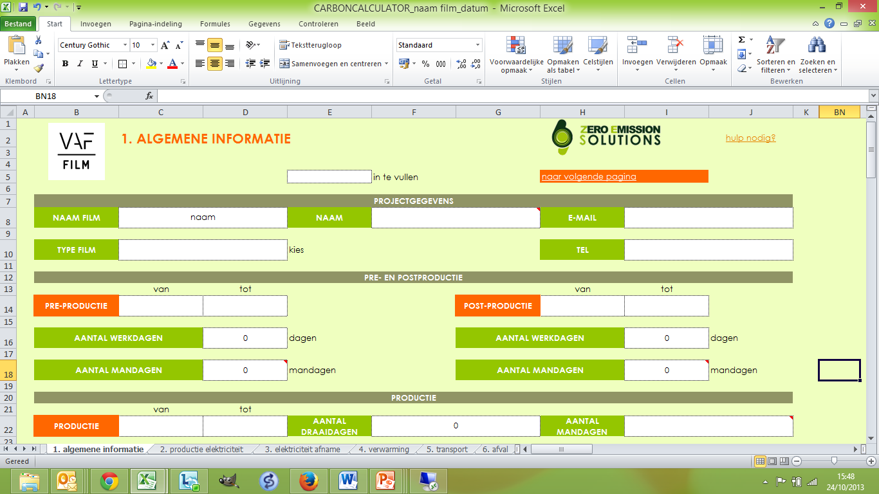
Carbon Calculator
ecological sustainability of Flanders’ film production industry

Slide 6
Carbon footprint of the Flemish film sector
Deskresearch
A lot of information was gathered:
A carbon calculation of six films
four films that were recently produced
Set- and desk research on two films in (pre-)production
Emission: 52,44 ton CO2 - 159,44 ton CO2 per film
ecological sustainability of Flanders’ film production industry
Notes:
Desk research on four films that were recently produced = carbon calculation
The Broken Circle Breakdown (Menuet – Belgium’s Oscar candidate)
Allez Eddy (an international co-production)
Brasserie Romantique (a film mainly shot in studio)
Tot Altijd / Time of my Life (attention for sustainable production during production)
(budget of the films between € 1 mio and € 3,5 mio)
Set- and desk research on two films in (pre-)production = consultations on working methods with the crew + starting up the coaching mechanism
Welp (horror movie)
Labyrinth (Savage Films)

Slide 7
TRIAS ENERGETICA
ecodriving
Bikes
Carpoolen
Prevent and reuse litter
Ecolabel- FSC
Strategic Choice Locations
Trucks stay overnight
Hotel overnight
1. REDUCE
Sustainable catering
Green electricity
LED
Generator on biofuel
Ecological cars
Hybride cars
Decor, costumes, props reuse / rent
Recycle litter
3. EFFICIENCY
2. SUSTAINABLE SOURCES
ecological sustainability of Flanders’ film production industry
Notes:
First, we need to limit energy demand through energy saving. Second, renewable sources should be used to meet the remaining energy demand. Only then should fossil fuels be used, as efficiently and cleanly as possible
No extra cost / limited budget
No investments
Limited time
Easy to implement
Practical tips

Slide 8
Tools that help filmmakers
A lot of working tools were developed:
Brochure ‘methodology’: why would you produce in a more sustainable way? Approach? Basic rules? How far can you go? …
Communication
Good start
Shared responsability
Pre-production
Checklists for key departments (production, location manager catering, location manager waste, costume, set decoration)
Tools (hotel <> transport / hybrid cars <> classical cars)
Flash cards with best practices
Partners found for hybrid car rental,
for waste handling on set, for rental of 30% biodiesel
generators
ecological sustainability of Flanders’ film production industry
Notes:
Desk research on four films that were recently produced = carbon calculation
The Broken Circle Breakdown (Menuet – Belgium’s Oscar candidate)
Allez Eddy (an international co-production)
Brasserie Romantique (a film mainly shot in studio)
Tot Altijd / Time of my Life (attention for sustainable production during production)
(budget of the films between € 1 mio and € 3,5 mio)
Set- and desk research on two films in (pre-)production = consultations on working methods with the crew + starting up the coaching mechanism
Welp (horror movie)
Labyrinth (Savage Films)

Slide 9
Sensibilisation and information towards filmmakers
Engaging the broader sector: since September 2013 each feature film that gets VAF-production support is engaged in the e-Mission project:
Having to participate to an information session of ½ day
Being asked to make an effort to produce in a more sustainable way
Being asked to collect relevant data and to fill in the carbon calculator
Being coached by ZES during the whole process
All along, carbon calculator, checklists and tools will be refined
ecological sustainability of Flanders’ film production industry
Notes:
Desk research on four films that were recently produced = carbon calculation
The Broken Circle Breakdown (Menuet – Belgium’s Oscar candidate)
Allez Eddy (an international co-production)
Brasserie Romantique (a film mainly shot in studio)
Tot Altijd / Time of my Life (attention for sustainable production during production)
(budget of the films between € 1 mio and € 3,5 mio)
Set- and desk research on two films in (pre-)production = consultations on working methods with the crew + starting up the coaching mechanism
Welp (horror movie)
Labyrinth (Savage Films)

Slide 10
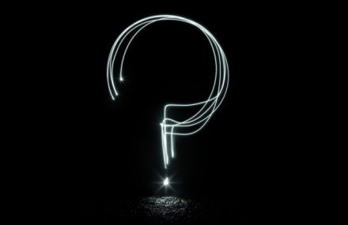
Siebe Dumon
++32 (0)2 226 06 30
sdumon@vaf.be
Kim Van den Heuvel
++32 (0)498 10 79 93 kim.vandenheuvel@zeroemissionsolutions.com
VAF Workshop

